Slide 1
ASP.NET MVC 5

Slide 2
Web Forms (Old ASP.NET)
MVC
ASP.NET
.NET Framework

Slide 3
MVC → Model View Controller
End User
Data & Logic
WCF Service
Model
Data Layer
Co-ordinator
Browser
Controller
Look & feel
View

Slide 4
ASP.NET MVC Life Cycle
Product.cs
Model
End User
Add Product
Controller
View
Product.aspx
Product.cshtml
Product.vbhtml

Slide 5
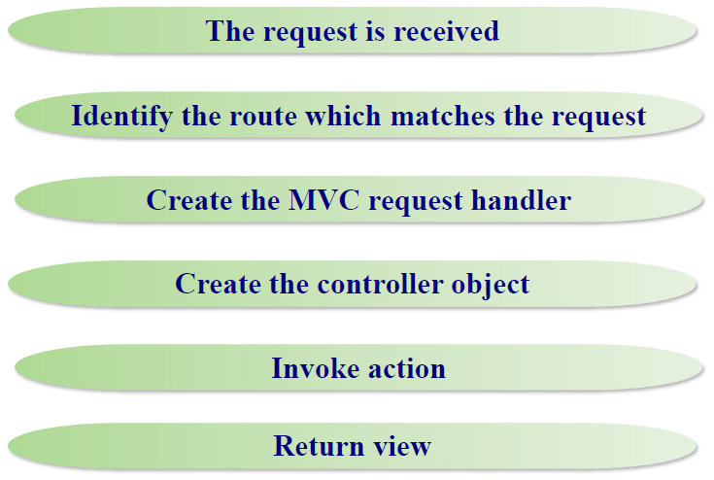
ASP.NET MVC Life Cycle

Slide 6
Simple Example of MVC
Model
End User
Controller
View

Slide 7
ActionResult Return Type
Result Class | Description | Base Controller method
ViewResult | Represents HTML and markup. | View()
EmptyResult | Represents No response.
ContentResult | Represents string literal. | Content()
JsonResult | Represent JSON that can be used in AJAX | Json()
RedirectResult | Represents a redirection to a new URL | Redirect()
RedirectToRouteResult | Represent another action of same or other controller | RedirectToRoute()
PartialViewResult | Returns HTML | PartialView()
HttpUnauthorizedResult | Returns HTTP 403 status

Slide 8
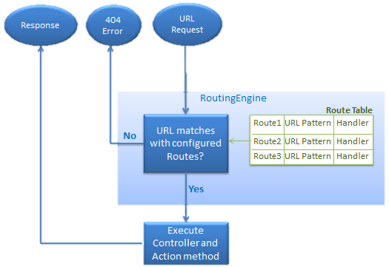
How does Routing work in MVC?

Slide 9
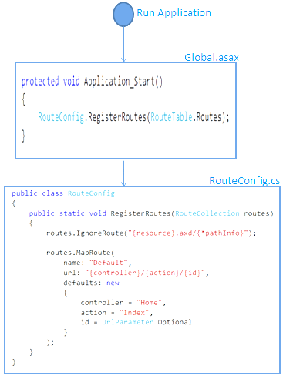
Route Registration Process

Slide 10
Summary on Routing
Routing simplifies MVC URL.
Routing plays important role in MVC framework. Routing maps URL to physical file or class (controller class in MVC).
Routes can be configured in RouteConfig class. Multiple custom routes can be configured using RouteCollection.
RouteCollection has two Methods:
MapRoute – to invoke actions and call views
IgnoreRoute – to avoid the user to access particular files or download them
Route must be registered in Application_Start event in Global.ascx.cs file.
Routing help is achieving greater Search Engine Optimization (SEO)

